Slide 1

STIA1123 Programming 2
User-Defined Class

Slide 2
Objectives
To describe objects and classes, and use classes to model objects
To use UML graphical notation to describe classes and objects
To demonstrate how to define classes and create objects
To create objects using constructors
To access objects via object reference variables
To define a reference variable using a reference type
To access an object’s data and methods using the object member access operator (.)
To define data fields of reference types and assign default values for an object’s data fields
To distinguish between object reference variables and primitive data type variables
To distinguish between instance and static variables and methods
To define private data fields with appropriate get and set methods
To encapsulate data fields to make classes easy to maintain
To develop methods with object arguments and differentiate between primitive-type arguments and object-type arguments
To store and process objects in arrays
To write method overloading
‹#›

Slide 3
Writing Classes
The programs we’ve written in previous examples have used classes defined in the Java standard class library
Now we will begin to design programs that rely on classes that we write ourselves
The class that contains the main method is just the starting point of a program
True object-oriented programming is based on defining classes that represent objects with well-defined characteristics and functionality
4-‹#›

Slide 4
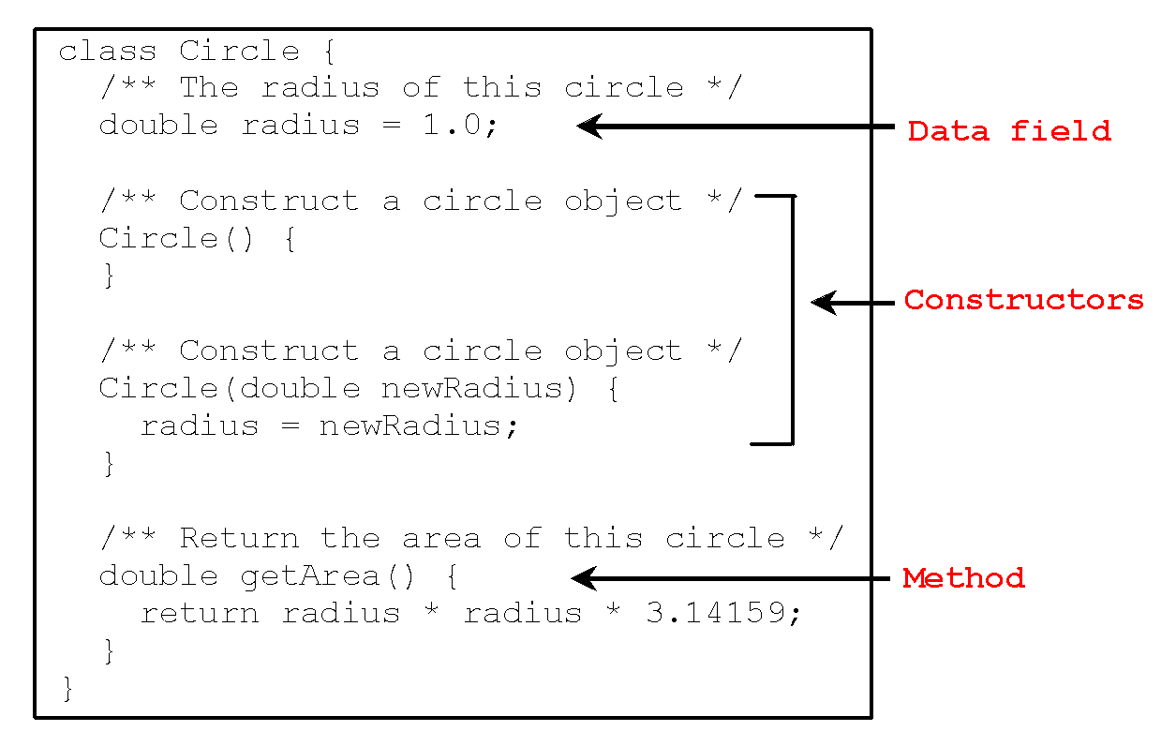
Example: User Defined Class
‹#›

Slide 5
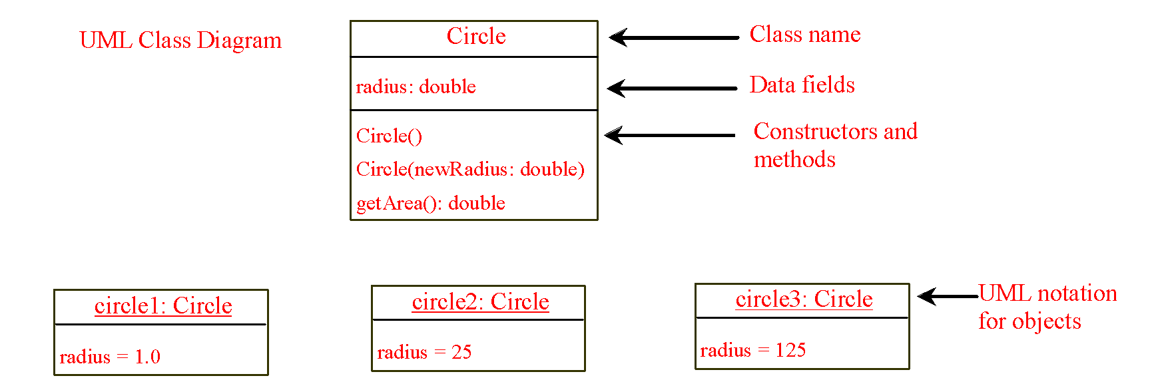
UML Class Diagram
‹#›

Slide 6
Example: Defining Driver Classes and Creating Objects
Objective: Demonstrate creating objects, accessing data, and using methods.
public class TestCircle {
public static void main(String[] args) {
Circle circle1 = new Circle();
Circle circle2 = new Circle(2.5);
Circle circle3 = new Circle(125);
System.out.println("Circle 1: Radius="+circle1.radius
+" Area= "+circle1.getArea());
System.out.println("Circle 2: Radius="+circle2.radius
+" Area= "+circle2.getArea());
System.out.println("Circle 3: Radius="+circle3.radius
+" Area= "+circle3.getArea());
}//end main
}//end class
‹#›

Slide 7
Constructors
Circle() {
}
Circle(double newRadius) {
radius = newRadius;
}
Constructors are a special kind of methods that are invoked to construct objects.
‹#›

Slide 8
Constructors, cont.
A constructor with no parameters is referred to as a no-arg constructor.
Constructors must have the same name as the class itself.
Constructors do not have a return type—not even void.
Constructors are invoked using the new operator when an object is created. Constructors play the role of initializing objects.
‹#›

Slide 9
Creating Objects Using Constructors
new ClassName();
Example:
new Circle();// using no-arg constructor
new Circle(5.0);
‹#›

Slide 10
Default Constructor
A class may be defined without constructors. In this case, a no-arg constructor with an empty body is implicitly declared in the class. This constructor, called a default constructor, is provided automatically only if no constructors are explicitly defined in the class.
‹#›

Slide 11
Declaring Object Reference Variables
To reference an object, assign the object to a reference variable.
To declare a reference variable, use the syntax:
ClassName objectRefVar;
Example:
Circle myCircle;
‹#›

Slide 12
Declaring/Creating Objects in a Single Step
ClassName objectRefVar = new ClassName();
Example:
Circle myCircle = new Circle();
Assign object reference
Create an object
‹#›

Slide 13
Accessing Object’s Members
Referencing the object’s data:
objectRefVar.data
e.g., myCircle.radius
Invoking the object’s method:
objectRefVar.methodName(arguments)
e.g., myCircle.getArea()
‹#›

Slide 14
Trace Code
animation
Declare myCircle
Circle myCircle = new Circle(5.0);
Circle yourCircle = new Circle();
yourCircle.radius = 100;
myCircle
no value
‹#›

Slide 15
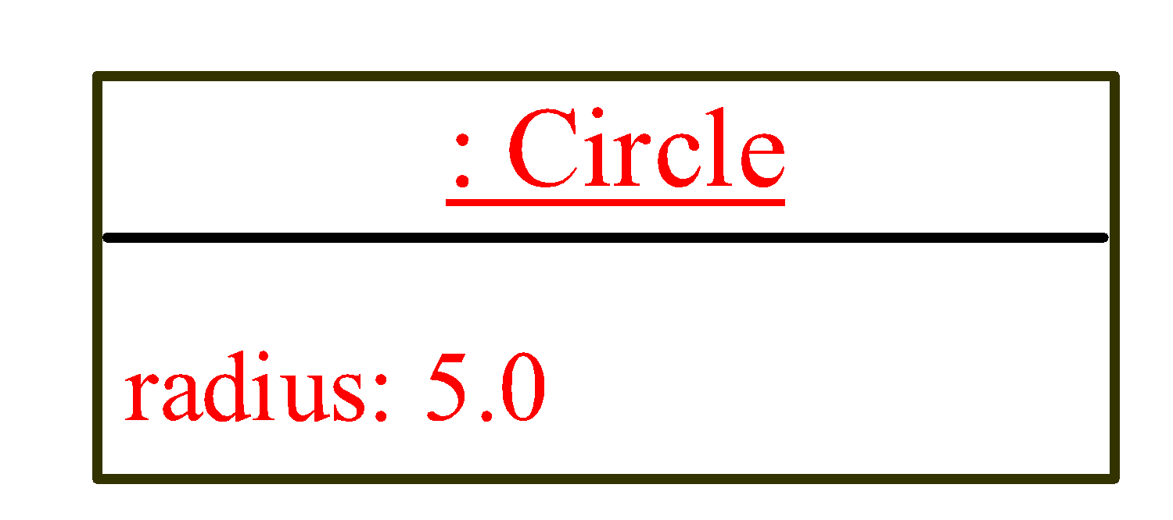
Trace Code, cont.
Circle myCircle = new Circle(5.0);
Circle yourCircle = new Circle();
yourCircle.radius = 100;
myCircle
no value
Create a circle
‹#›

Slide 16
Trace Code, cont.
Circle myCircle = new Circle(5.0);
Circle yourCircle = new Circle();
yourCircle.radius = 100;
myCircle
reference value
Assign object reference to myCircle
‹#›

Slide 17
Trace Code, cont.
Circle myCircle = new Circle(5.0);
Circle yourCircle = new Circle();
yourCircle.radius = 100;
myCircle
reference value
yourCircle
no value
Declare yourCircle
‹#›

Slide 18
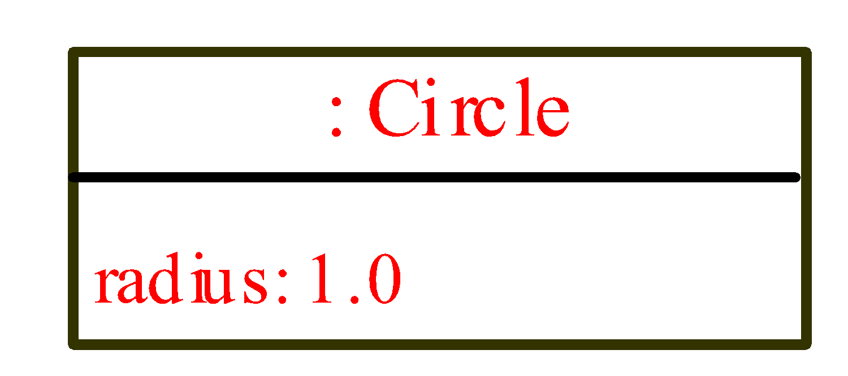
Trace Code, cont.
Circle myCircle = new Circle(5.0);
Circle yourCircle = new Circle();
yourCircle.radius = 100;
myCircle
reference value
yourCircle
no value
Create a new Circle object
‹#›

Slide 19
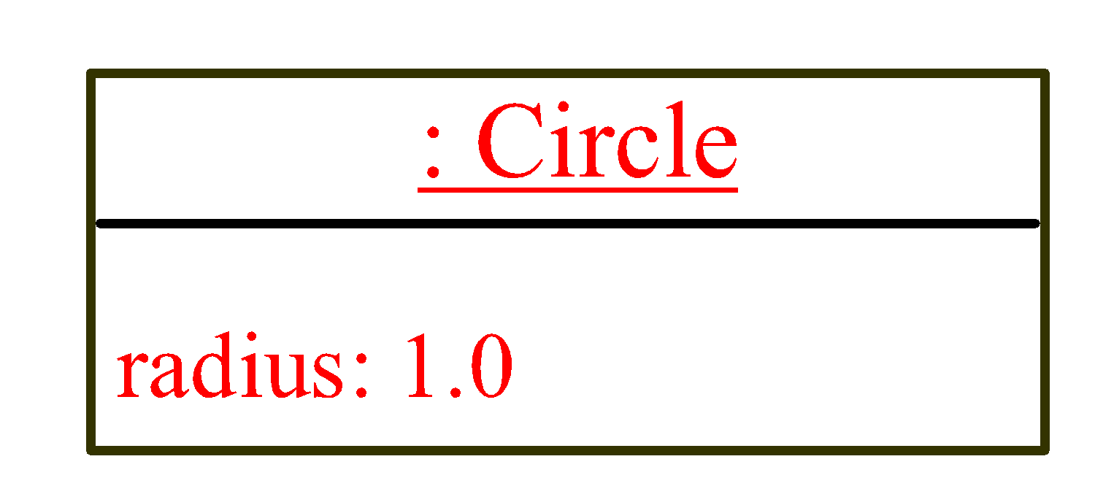
Trace Code, cont.
Circle myCircle = new Circle(5.0);
Circle yourCircle = new Circle();
yourCircle.radius = 100;
myCircle
reference value
yourCircle
reference value
Assign object reference to yourCircle
‹#›

Slide 20
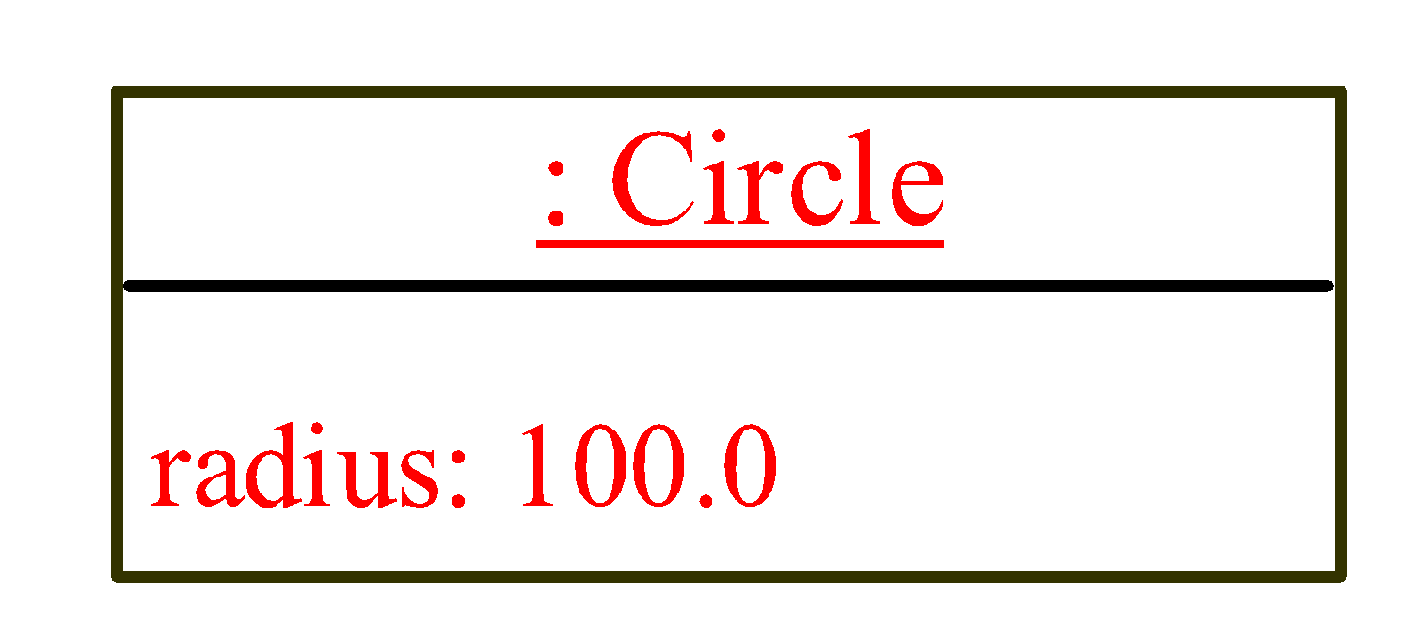
Trace Code, cont.
Circle myCircle = new Circle(5.0);
Circle yourCircle = new Circle();
yourCircle.radius = 100;
myCircle
reference value
yourCircle
reference value
Change radius in yourCircle
‹#›

Slide 21
Caution
Recall that you use
Math.methodName(arguments) (e.g., Math.pow(3, 2.5))
to invoke a method in the Math class.
Can you invoke getArea() using Circle1.getArea()? The answer is no.
All the methods used before this are static methods, which are defined using the static keyword. However, getArea() is non-static. It must be invoked from an object using
objectRefVar.methodName(arguments) (e.g., myCircle.getArea()).
More explanations will be given in the section on “Static Variables, Constants, and Methods.”
‹#›

Slide 22
Reference Data Fields
The data fields can be of reference types. For example, the following Student class contains a data field name of the String type.
public class Student {
String name; // name has default value null
int age; // age has default value 0
boolean isScienceMajor; // isScienceMajor has default value false
char gender; // c has default value '\u0000'
}
‹#›

Slide 23
The null Value
If a data field of a reference type does not reference any object, the data field holds a special literal value, null.
‹#›

Slide 24
Default Value for a Data Field
The default value of a data field is null for a reference type, 0 for a numeric type, false for a boolean type, and '\u0000' for a char type. However, Java assigns no default value to a local variable inside a method.
public class Test {
public static void main(String[] args) {
Student student = new Student();
System.out.println("name? " + student.name);
System.out.println("age? " + student.age);
System.out.println("isScienceMajor? " + student.isScienceMajor);
System.out.println("gender? " + student.gender);
}
}
‹#›

Slide 25
Example
Java assigns no default value to a local variable inside a method.
public class Test {
public static void main(String[] args) {
int x; // x has no default value
String y; // y has no default value
System.out.println("x is " + x);
System.out.println("y is " + y);
}
}
Compilation error: variables not initialized
‹#›

Slide 26
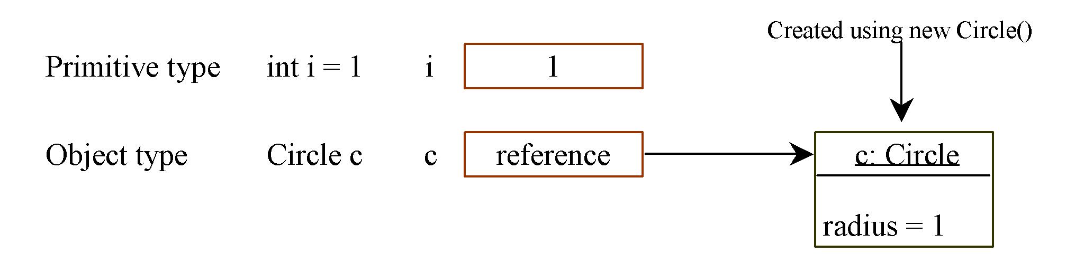
Differences between Variables of Primitive Data Types and Object Types
‹#›

Slide 27
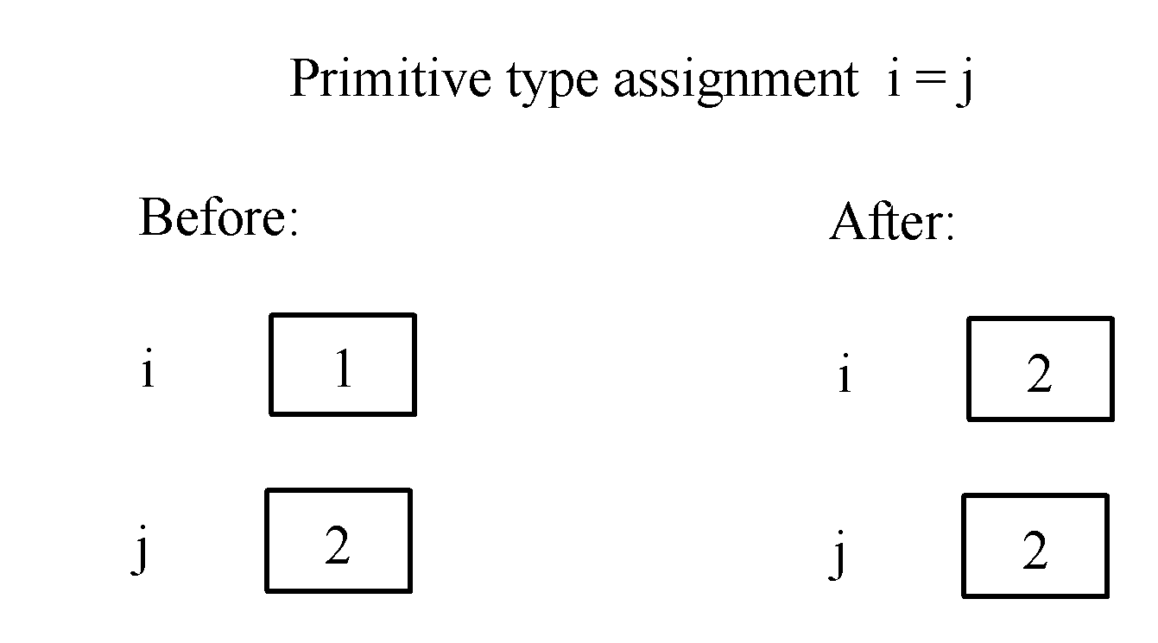
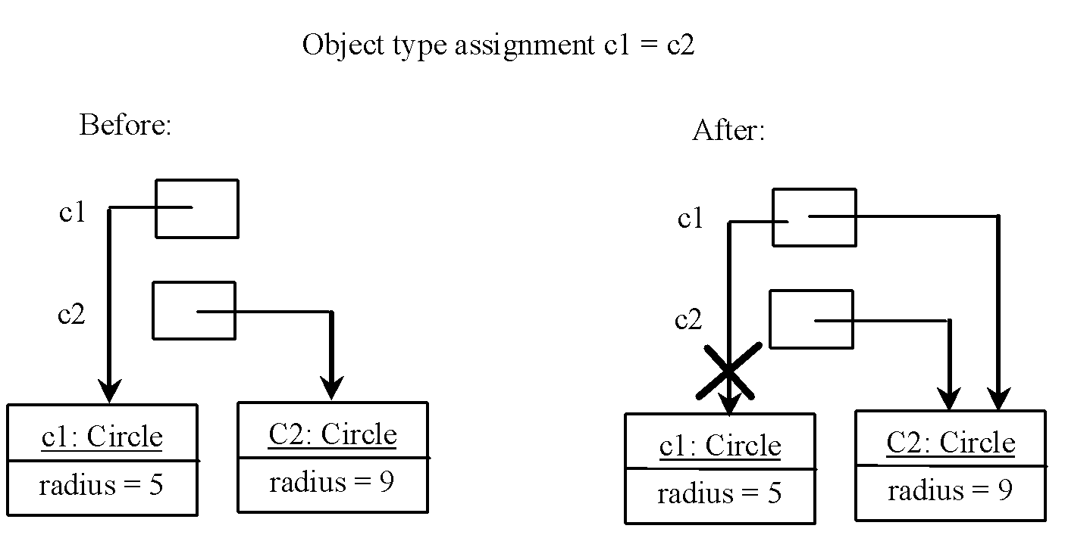
Copying Variables of Primitive Data Types and Object Types
‹#›

Slide 28
Garbage Collection
As shown in the previous figure, after the assignment statement c1 = c2, c1 points to the same object referenced by c2. The object previously referenced by c1 is no longer referenced. This object is known as garbage. Garbage is automatically collected by JVM.
‹#›

Slide 29
Garbage Collection, cont
TIP: If you know that an object is no longer needed, you can explicitly assign null to a reference variable for the object. The JVM will automatically collect the space if the object is not referenced by any variable.
‹#›

Slide 30
Instance Variables, and Methods
Instance variables belong to a specific instance.
Instance methods are invoked by an instance of the class.
‹#›

Slide 31
Static Variables, Constants, and Methods
Static variables are shared by all the instances of the class.
Static methods are not tied to a specific object.
Static constants are final variables shared by all the instances of the class.
‹#›

Slide 32
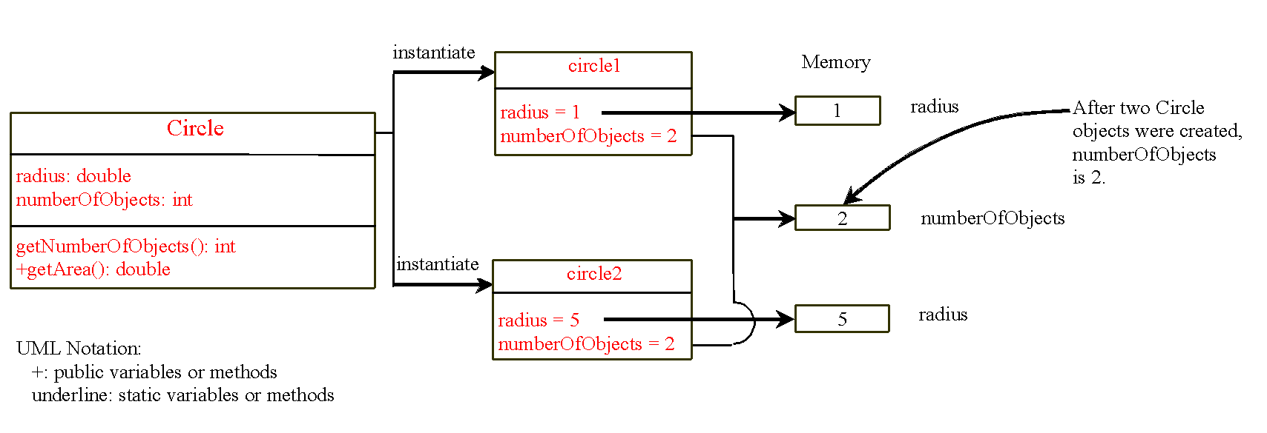
Static Variables, Constants, and Methods, cont.
To declare static variables, constants, and methods, use the static modifier.
‹#›

Slide 33
Example of Using Instance and Static/Class Variables and Method
Objective: Demonstrate the roles of instance and class variables and their uses. This example adds a static/class variable numberOfObjects to track the number of Circle objects created.
public class Circle {
double radius=1.0;
static int numberOfObjects;
Circle(){
numberOfObjects++;
}
Circle(double newRadius){
radius=newRadius;
numberOfObjects++;
}
double getArea(){
return Math.pow(radius,2)*Math.PI;
}
static int getNumberOfObjects(){
return numberOfObjects;
}
}//end class
‹#›

Slide 34
Example of Using Instance and Static/Class Variables and Method
public class TestCircle {
public static void main(String[] args) {
Circle circle1 = new Circle();
System.out.println("Circle 1: Radius="+circle1.radius
+" Area= "+circle1.getArea());
System.out.println("Number of Circle objects: “
+ Circle.numberOfObjects);
Circle circle2 = new Circle(2.5);
System.out.println("Circle 2: Radius="+circle2.radius
+" Area= "+circle2.getArea());
System.out.println("Number of Circle objects: “
+ Circle.numberOfObjects);
System.out.println("Number of Circle objects: "
+ Circle.getNumberOfObjects());
}
}

Slide 35
Visibility Modifiers and Accessor/Mutator Methods
By default, the class, variable, or method can be accessed by any class in the same package.
public
The class, data, or method is visible to any class in any package.
private
The data or methods can be accessed only by the declaring class.
The get and set methods are used to read and modify private properties.
‹#›

Slide 36
Accessors and Mutators
Because instance data is private, a class usually provides services to access and modify data values
An accessor method returns the current value of a variable
A mutator method changes the value of a variable
The names of accessor and mutator methods take the form getX and setX, respectively, where X is the name of the value
They are sometimes called “getters” and “setters”
4-‹#›

Slide 37
Mutator Restrictions
The use of mutators gives the class designer the ability to restrict a client’s options to modify an object’s state
A mutator is often designed so that the values of variables can be set only within particular limits
4-‹#›

Slide 38
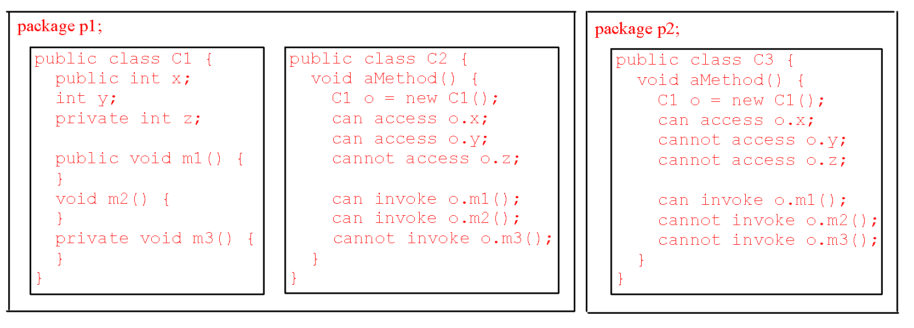
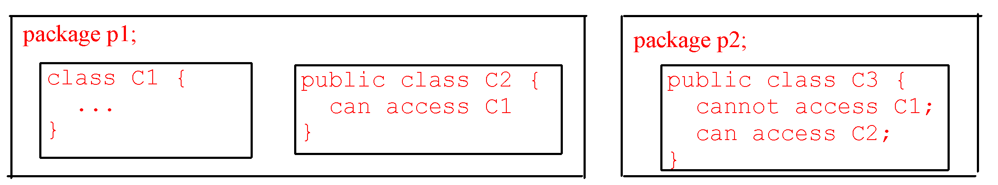
The private modifier restricts access to within a class, the default modifier restricts access to within a package, and the public modifier enables unrestricted access.
‹#›

Slide 39
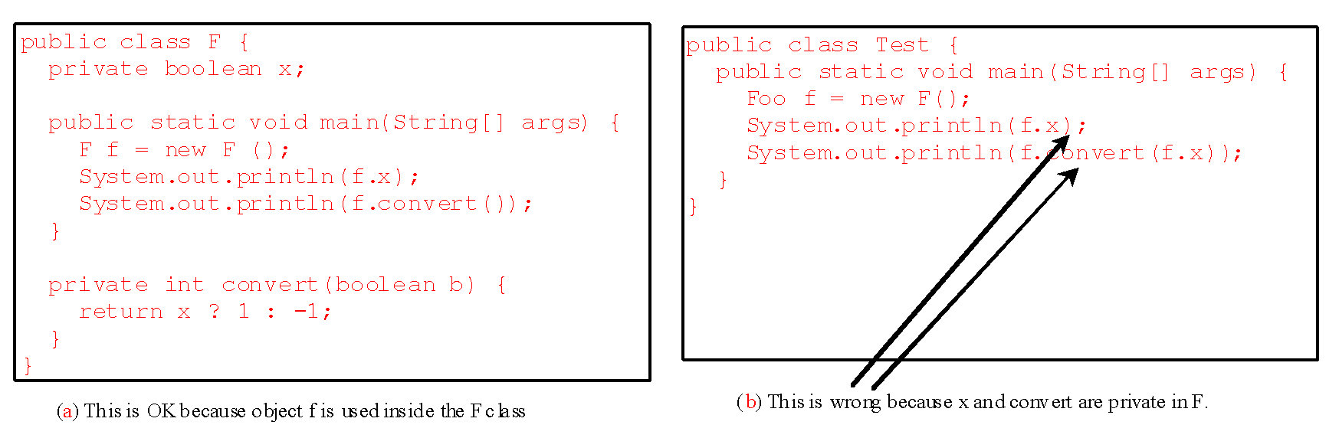
NOTE
An object cannot access its private members, as shown in (b). It is OK, however, if the object is declared in its own class, as shown in (a).
‹#›

Slide 40
Why Data Fields Should Be private?
To protect data.
To make class easy to maintain.
‹#›

Slide 41
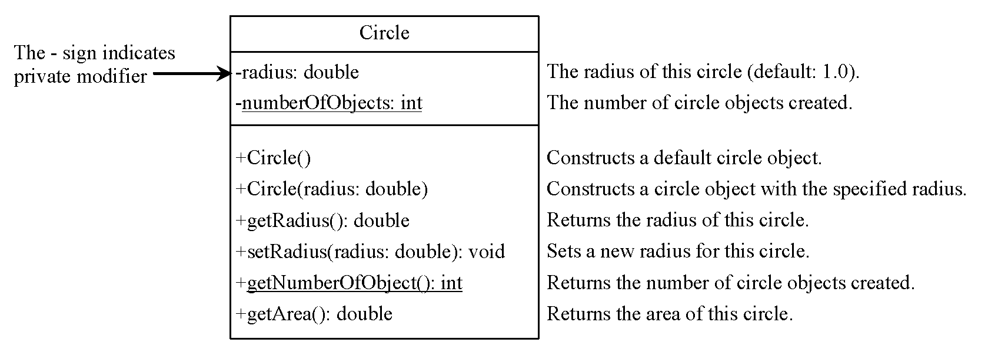
Example of Data Field Encapsulation
‹#›

Slide 42
Passing Objects to Methods
Passing by value for primitive type value (the value is passed to the parameter)
Passing by value for reference type value (the value is the reference to the object)
‹#›

Slide 43
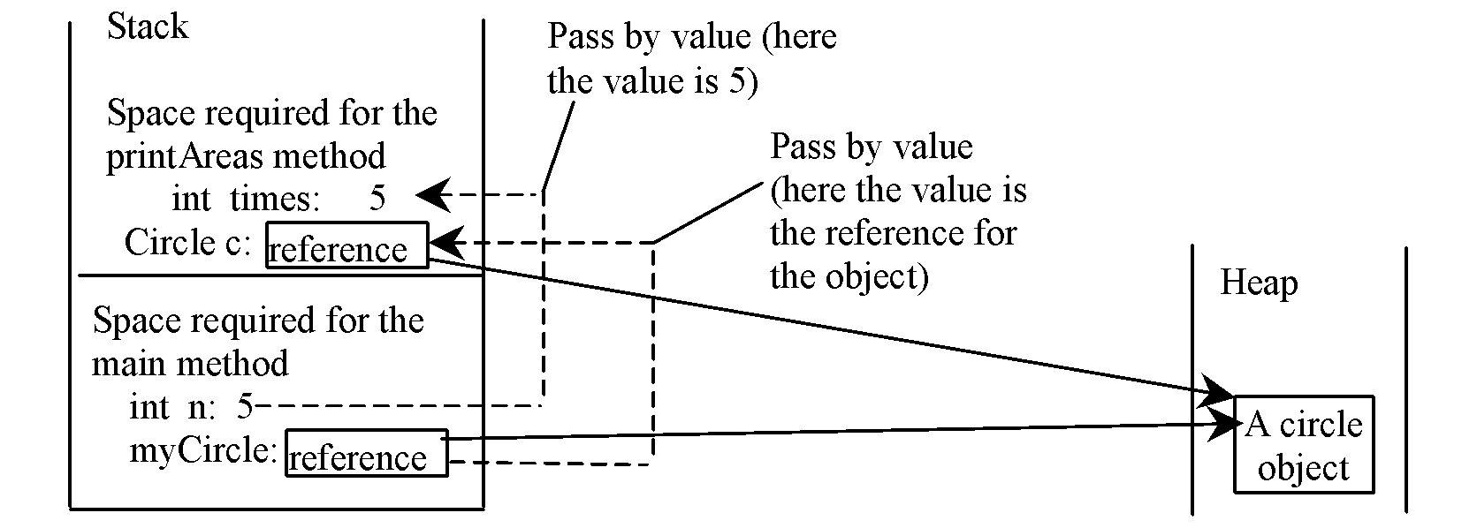
Passing Objects to Methods, cont.
‹#›

Slide 44
Arrays of Objects
In Java, in addition to create arrays of primitive data types (int, double, float, char etc), we can declare arrays of objects
An array of primitive data is a powerful tool, but an array of objects is even more powerful.
The use of an array of objects allows us to model the application more cleanly and logically.

Slide 45
Array of Objects
Circle[] circleArray = new Circle[10];
An array of objects is actually an array of reference variables. So invoking circleArray[1].getArea() involves two levels of referencing as shown in the next figure.
circleArray references to the entire array.
circleArray[1] references to a Circle object.
‹#›

Slide 46
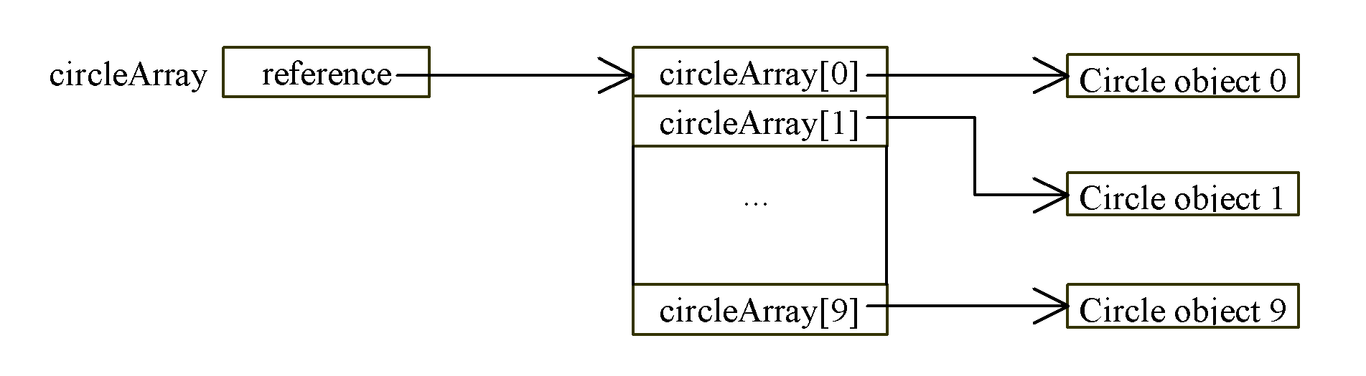
Array of Objects, cont.
Circle[] circleArray = new Circle[10];
‹#›

Slide 47
Array of Objects, cont.
Summarizing the areas of the circles
public class TestCircle {
static Circle [] arrCircle = new Circle[2];//array of Circle’s objects
static int i=0;
public static void main(String[] args) {
Circle circle1 = new Circle();
setArray(circle1);//passing object to methods
System.out.println("Circle 1: Radius="+circle1.getRadius()+" Area= "+circle1.getArea());
System.out.println("Number of Circle objects: "+ Circle.getNumberOfObjects());
circle1.setRadius(5.0);
Circle circle2 = new Circle(2.5);
setArray(circle2); //passing object to methods
System.out.println("Circle 2: Radius="+circle2.getRadius()+" Area= "+circle2.getArea());
// System.out.println("Number of Circle objects: "+ Circle.numberOfObjects);
System.out.println("Number of Circle objects: "+ Circle.getNumberOfObjects());
printArray();
}
‹#›

Slide 48
Array of Objects, cont.
public static void setArray(Circle c){ //c received address
arrCircle[i++]=c;
}//end setArray
public static void printArray(){
System.out.println("\n\n***Print from array of Circle objects***");
for (int i=0; i<arrCircle.length;i++ ){
System.out.println("Circle "+(i+1)
+": Radius="+arrCircle[i].getRadius()
+" Area= "+arrCircle[i].getArea());
}//end for
}//end printArray
}//end class

Slide 49
Method Overloading
In Java, within a class, several methods can have the same name. We called method overloading
Two methods are said to have different formal parameter lists:
If both methods have a different number of formal parameters
If the number of formal parameters is the same in both methods, the data type of the formal parameters in the order we list must differ in at least one position
‹#›

Slide 50
Method Overloading
Example:
public void methodABC()
public void methodABC(int x)
public void methodABC(int x, double y)
public void methodABC(double x, int y)
public void methodABC(char x, double y)
public void methodABC(String x,int y)
‹#›

Slide 51
Java code for overloading
public class Exam
{
public static void main (String [] args)
{
int test1=75, test2=68, total_test1, total_test2;
Exam midsem=new Exam();
total_test1 = midsem.result(test1);
System.out.println("Total test 1 : "+ total_test1);
total_test2 = midsem.result(test1,test2);
System.out.println("Total test 2 : "+ total_test2);
}
int result (int i)
{
return i++;
}
int result (int i, int j)
{
return ++i + j;
}
}
‹#›

Slide 52
Output
Total test 1 : 75
Total test 2 : 144
‹#›

Slide 53
Constructors Revisited
Properties of constructors:
Name of constructor same as the name of class
A constructor,even though it is a method, it has no type
Constructors are automatically executed when a class object is instantiated
A class can have more than one constructors – “constructor overloading”
which constructor executes depends on the type of value passed to the constructor when the object is instantiated
‹#›

Slide 54
Java code (constructor overloading)
public class Student
{ String name;
int age;
Student(String n, int a)
{ name = n; age = a;
System.out.println ("Name1 :" + name);
System.out.println ("Age1 :" + age);
}
Student(String n)
{
name = n; age = 18;
System.out.println ("Name2 :" + name);
System.out.println ("Age2 :" + age);
}
public static void main (String args[])
{
Student myStudent1=new Student("Adam",22);
Student myStudent2=new Student("Adlin");
}
}
‹#›

Slide 55
Output:
Name1 :Adam
Age1 :22
Name2 :Adlin
Age2 :18
‹#›

